Slide 1


ICT370L – Lab Expo
American University of Science & Technology
Faculty of Engineering and Computer Science
Department of Information and Communication Technology
Android Dice Game
- Alexandre Aratimos 12210062
- Boutros Boutros 12210116
- Ghazy Hader 12210460
Instructor: Dr. DHAINI Bassel

Slide 2

Outline
Introduction
Tools
Used
Screenshots
(1)
Screenshots
(2)
Problems Faced
Conclusions
Brief Discussion

Slide 3
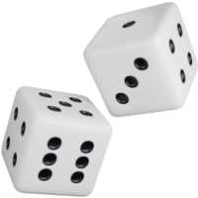
Introduction
Our project covers most of what we've learned in our Android development course.
We used advanced methods to make our project easy to understand and efficient.
In this project, we created an exceptional dice game, where you place a certain bet amount, roll the dices and try to win against the CPU.

Slide 4




Tools Used
Editor: Android Studio
Languages:
Drafts (for the database schema):

Slide 5
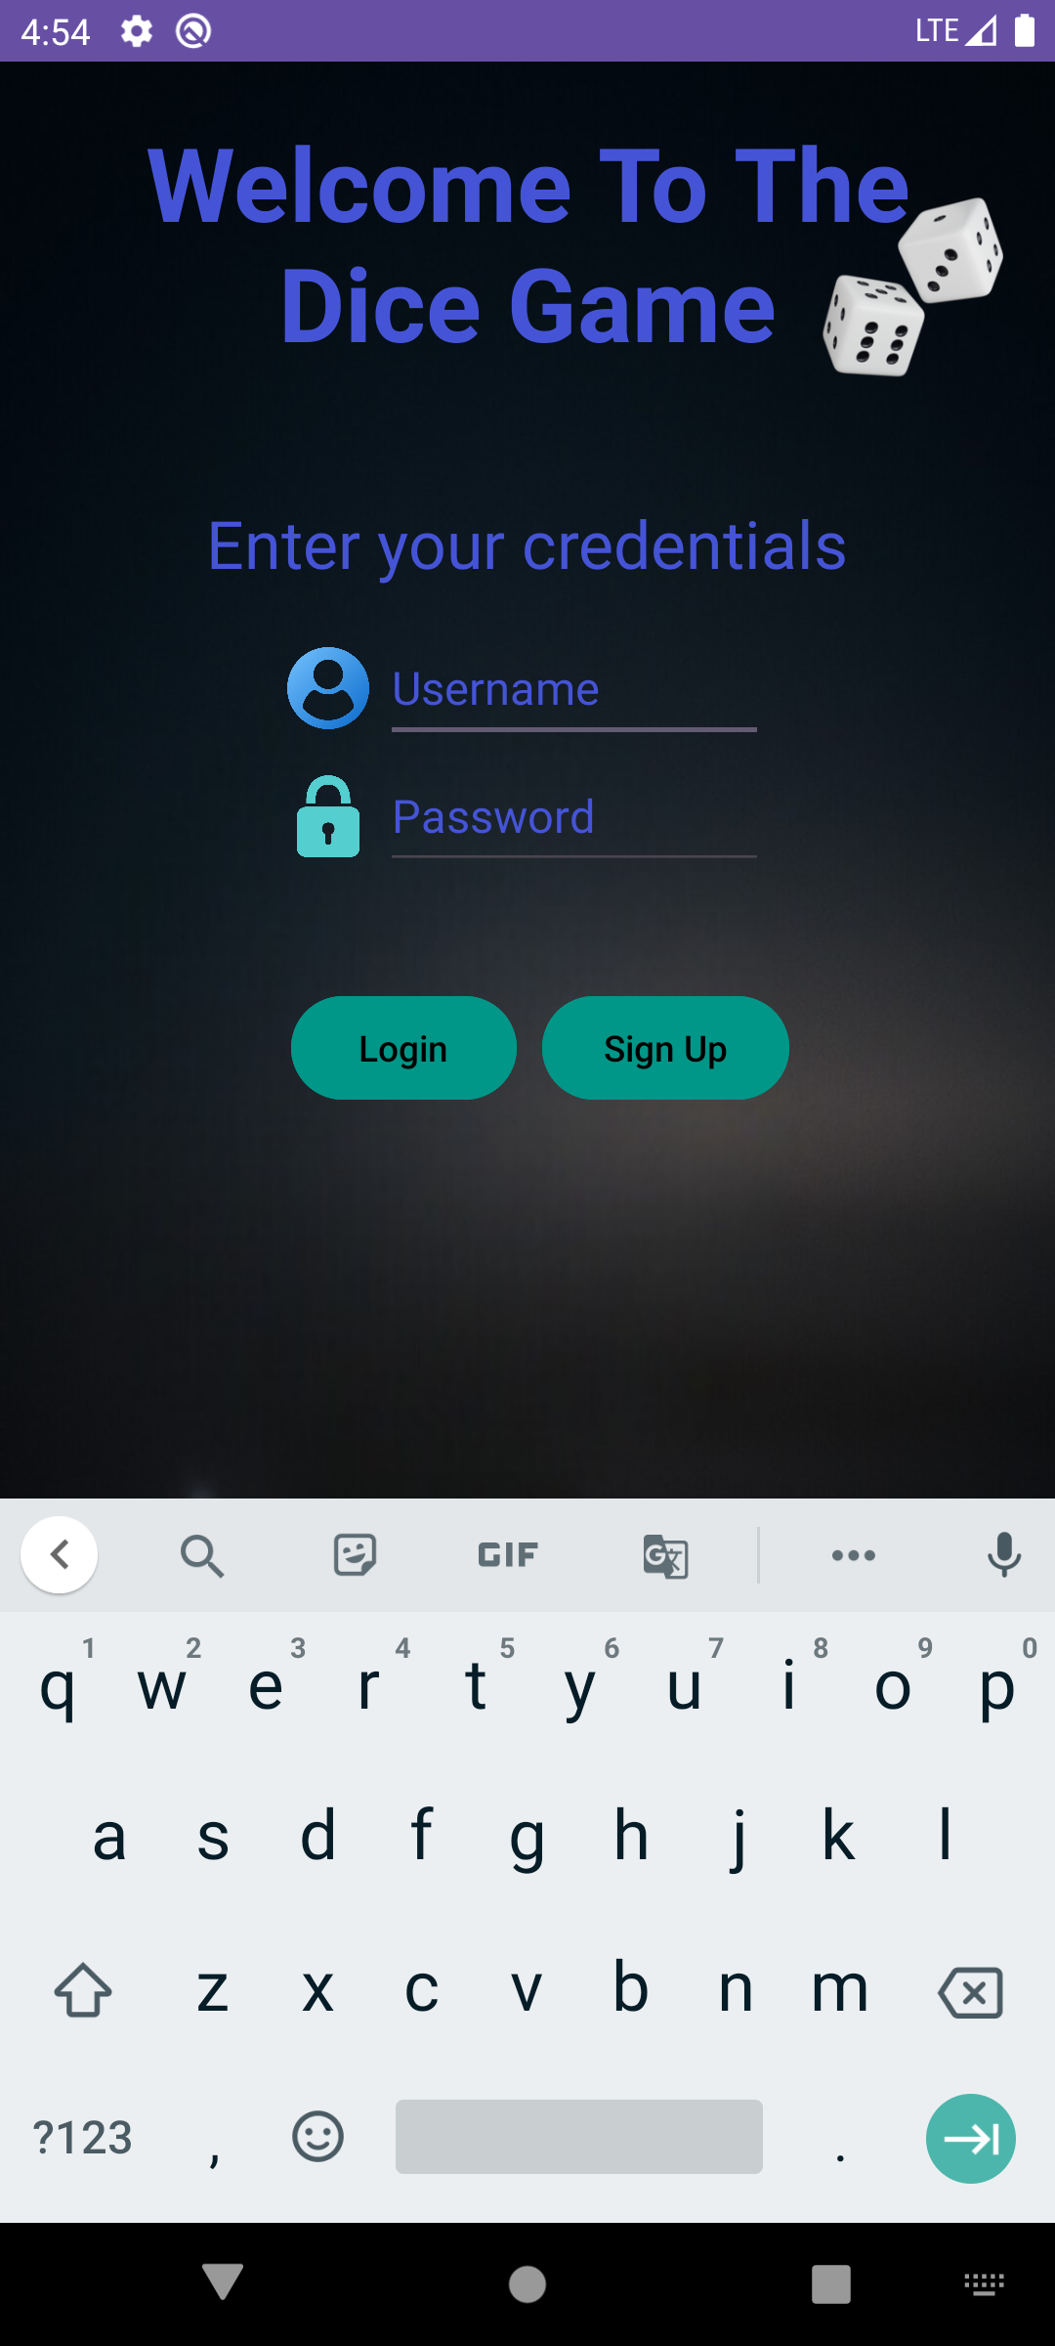
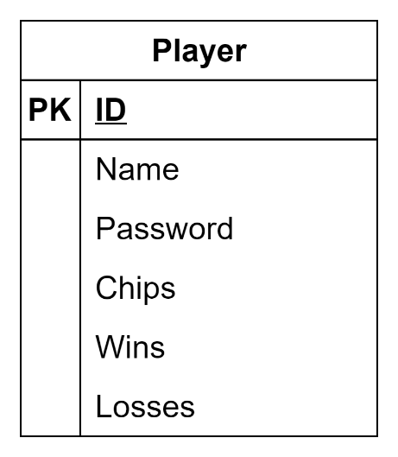
Screenshots (1 of 3)
Database
schema

Slide 6
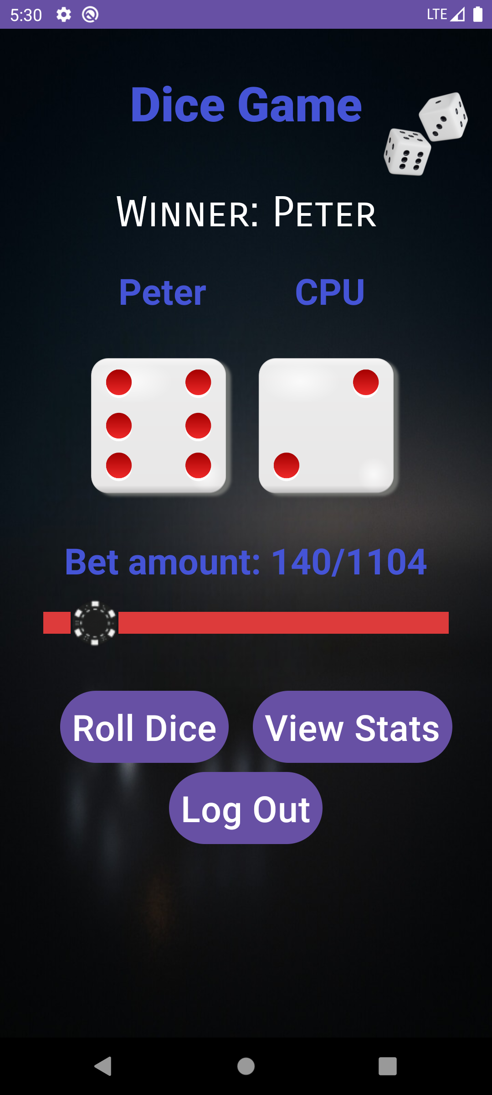
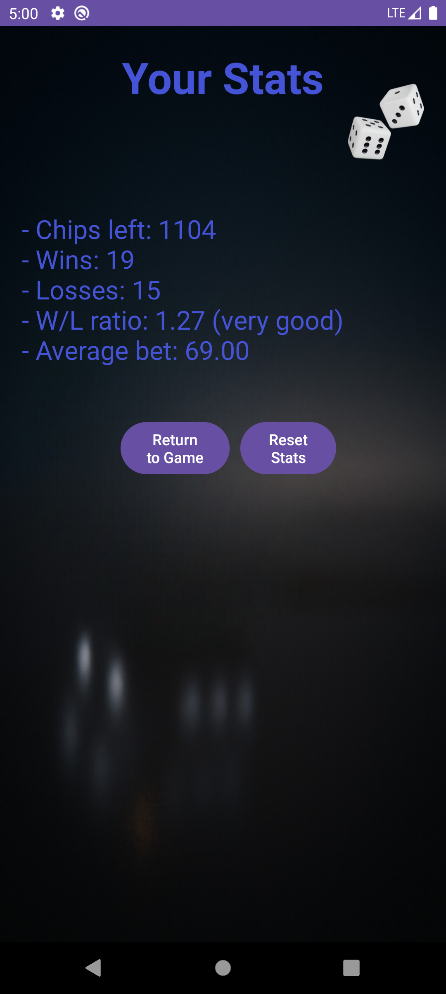
Screenshot (2 / 3)
Screenshots (3 of 3)

Slide 7
Brief Discussion
Login Activity is first launched, displaying the login form (screenshot 1).
After logging in/signing up, the game starts (Main Activity, screenshot 2).
The bet amount slider allows the player to set a specific bet amount, ranging from 1 to how many chips they have.
The button “Roll Dice” rolls both dices and plays a sound in the background.
“View Stats” lets the player see their stats (Stats Activity, screenshot 3).
The “Log out” button signs out the player, returning to Login Activity.

Slide 8
Problems Faced
Problem: game progress not saving after exiting
Solution: creating a database to safeguard each player’s data
Problem: repetition in some areas of the code
Solution: using more functions to reduce the size of the code
Problem: crashes occurring during runtime
Solution: catching and handling exceptions

Slide 9
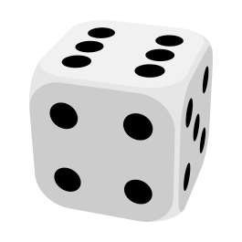
Conclusions
Our Android project is a big improvement in how we structured and handled the layouts and logic of our code.
By planning and building it carefully, we created an entertaining and casual game.
Using automated tasks (methods, classes, etc.) contributed to a smoother runtime and reduced manual effort.
The project encouraged us to work as a team, collaborate and be satisfied of the work done.

Slide 10

The End

